Slide 1
ASSIGNMENT – 8 J METER
J METER : The Apache Jmeter™ Application Is Open Source Software, A 100% Pure Java Application Designed To Load Test Functional Behavior And Measure Performance
THREAD : In JMETER, Each Thread Is One User.
THREAD GROUP : A Tg Is A Collection Of Threads(users).
TESTPLAN : Collections Of All Thread Groups, Config Elements.
SAMPLER : A Sampler Is A Request Sends By The Client To The Server In Manual Testing, We Call It As Test Case.
As A Tester, We Should Verify The Webpages Working On Server By Sending The Request To The Server, That
Is Why We Should Create The Samples In Jmeter.

Slide 2
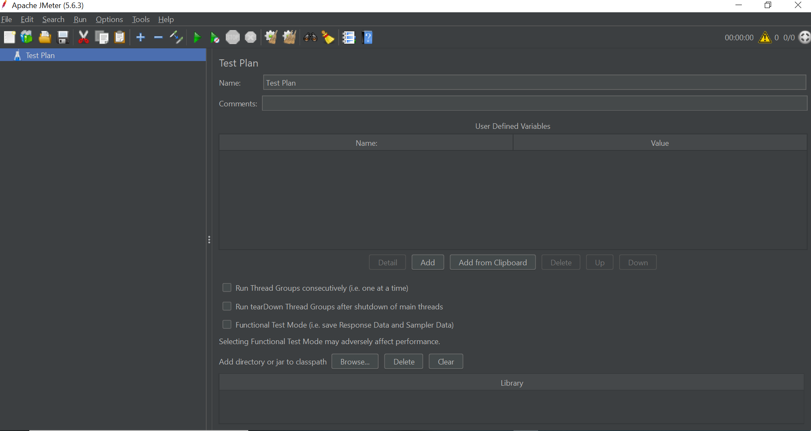
Shout down
Stop
save
Run Iocn
clear
Clear All listiner

Slide 3
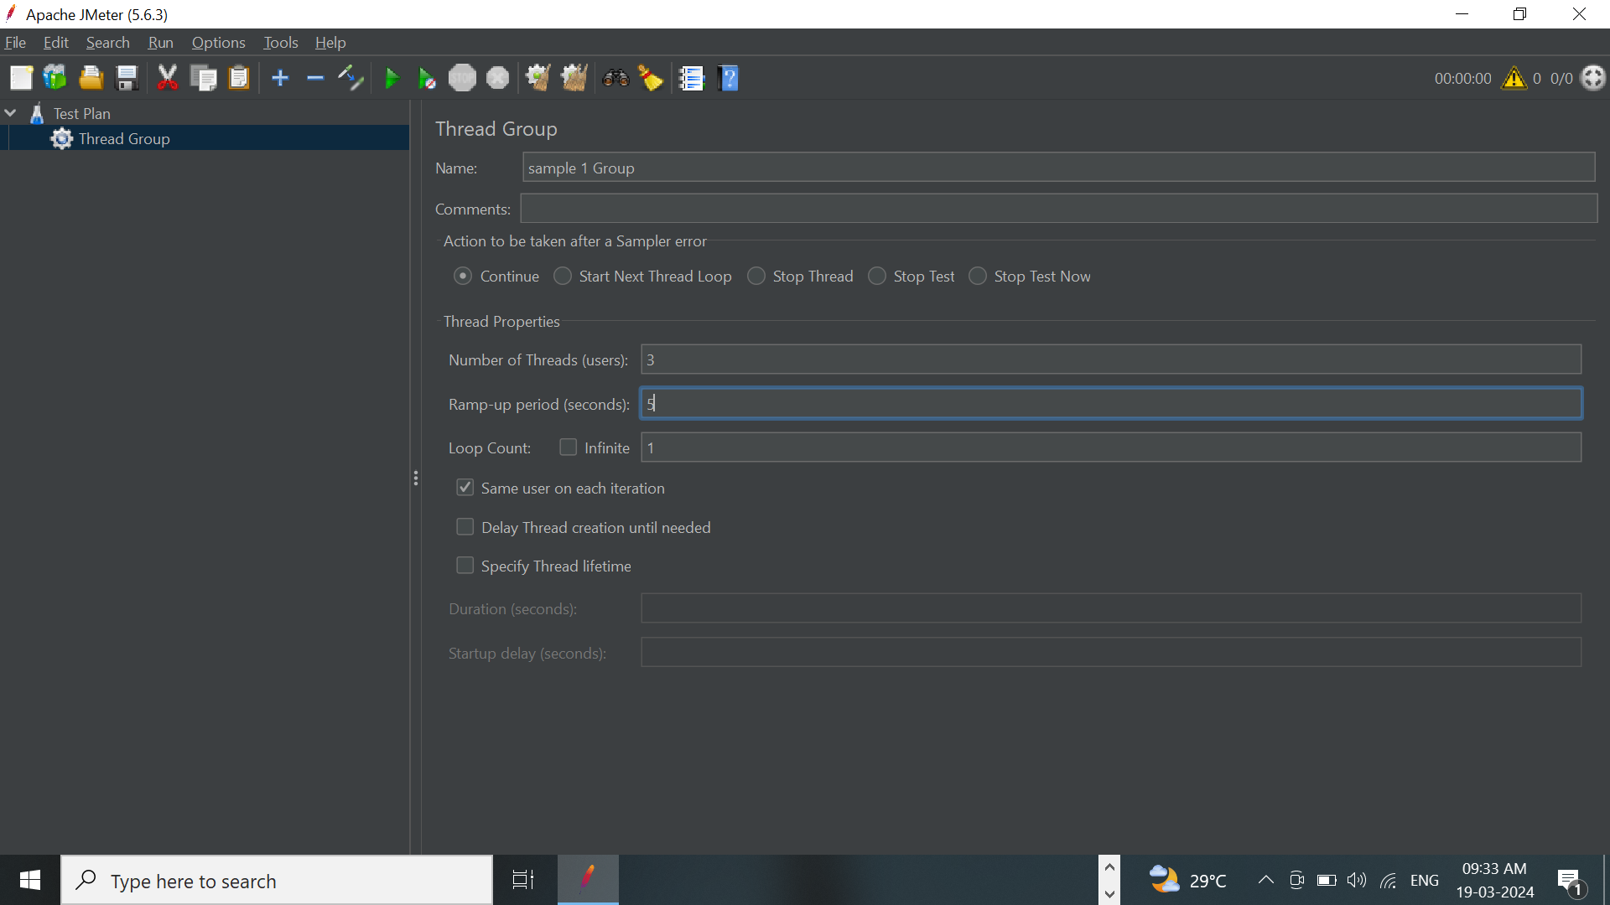
CREATE A TEST GROUP
Step 1 : Right click -> testplan -> add-> threads (users) -> thread group

Slide 4
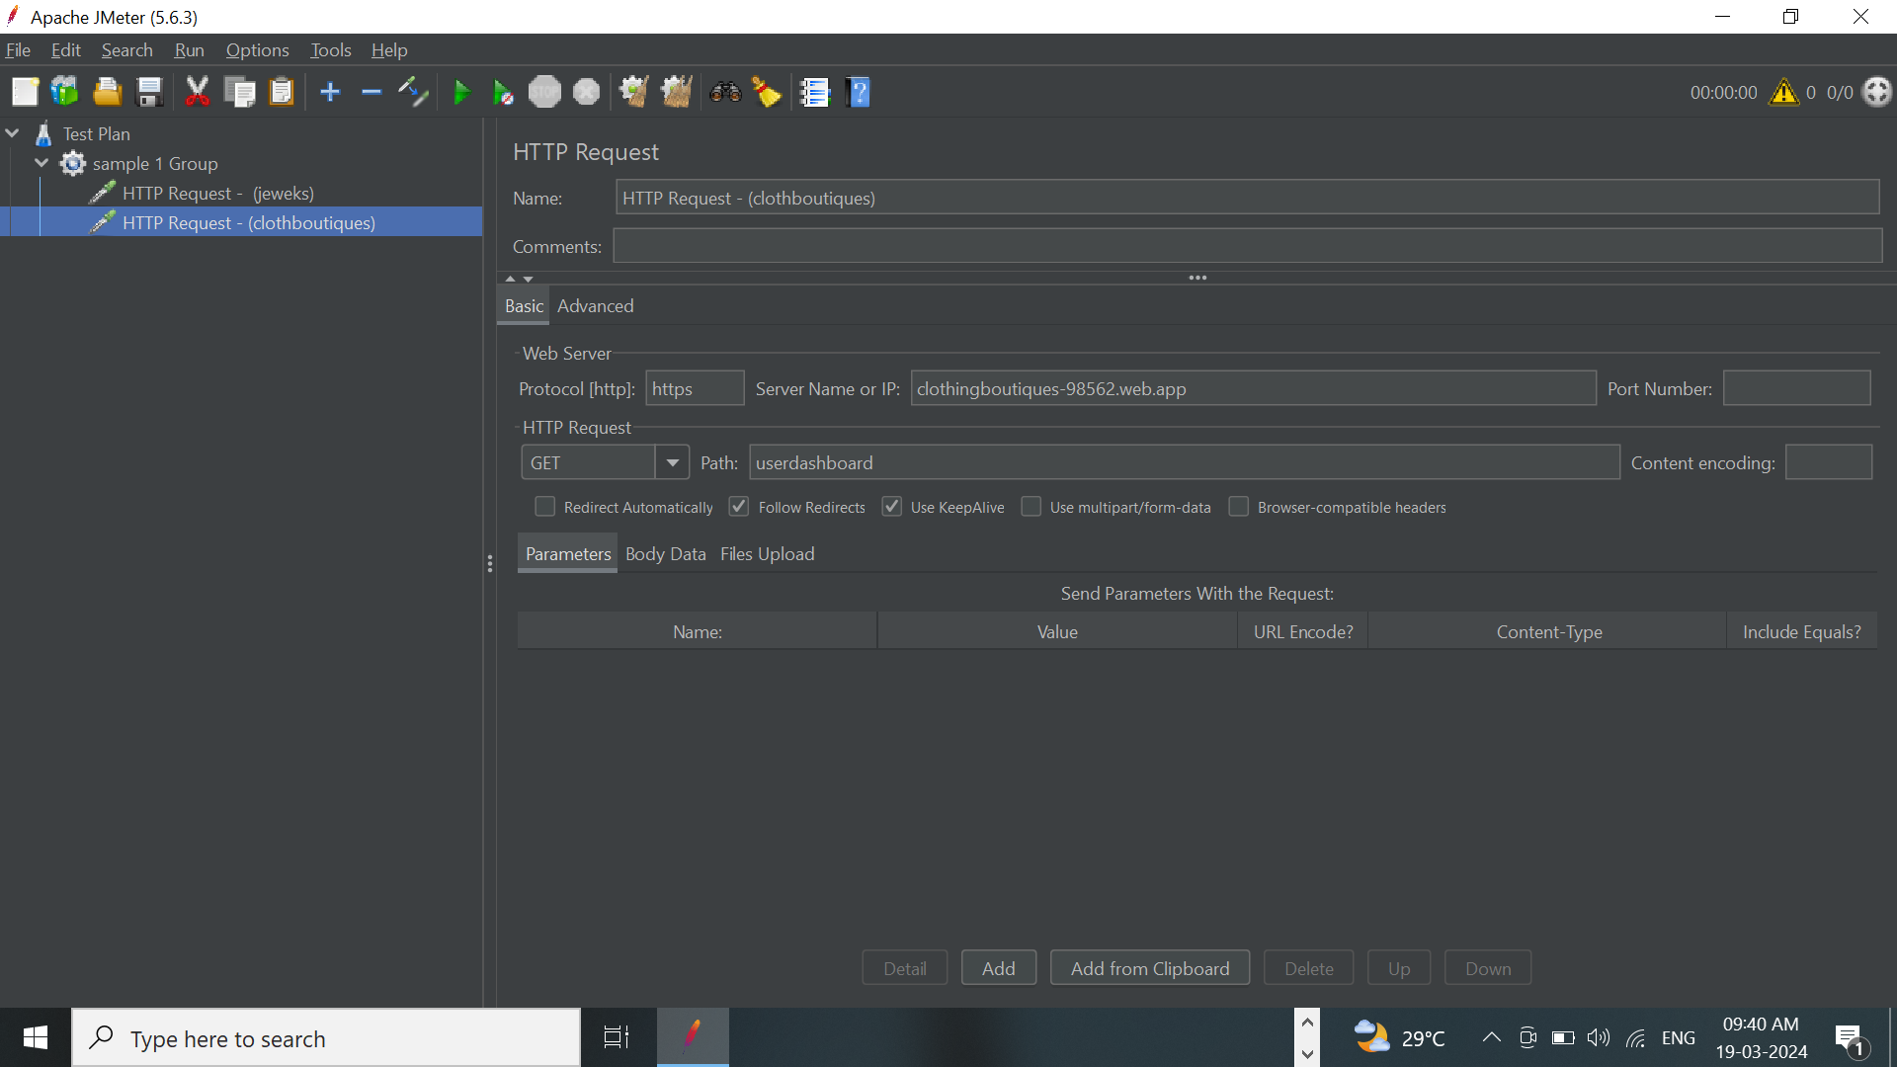
Create 2 samplers in each group :
Step 1 : Right click -> Test Group -> Add -> sampler -> http request

Slide 5

CREATE 4 LISTENERS IN EACH TEST GROUP :
Step 1 : Right Click -> Add -> Listeners -> (View Results In Table ,View Results Tree , Assertion Result ,
Summary Report, Aggregate Report )

Slide 6
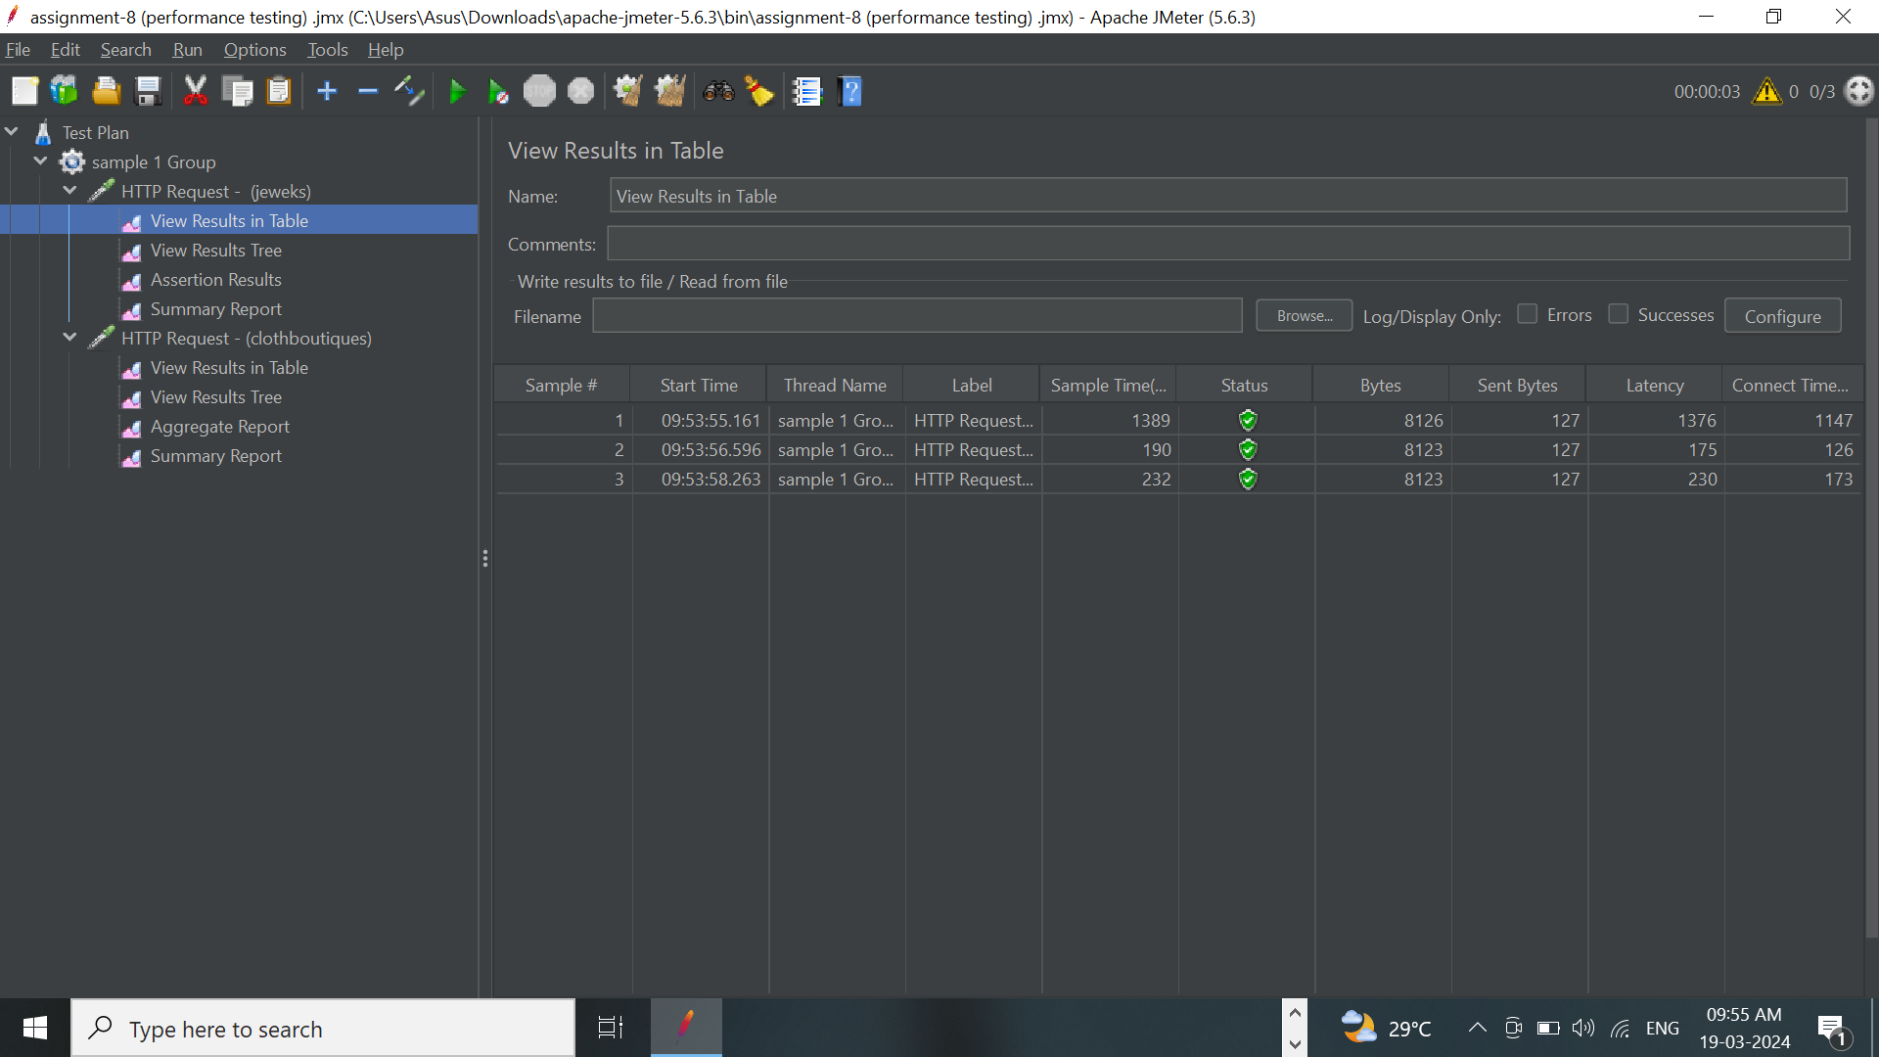
SAVE & RUN ALL LISTENERS :

